Slide 1
543: Supervisor Training Series
Module 4: Managing Diversity Through the Employment Process

Slide 2
Learning Objectives
Participants will be able to:
Define the supervisory role in managing diversity and creating inclusive environments in the workplace;
Explore work group issues related to culture; and
Identify methods to increase effective intercultural communication.

Slide 3
Idea Catcher
Don’t let a good idea get away!
People remember:
20% of what they hear
30% of what they see
70% of what they say
90% of what they do
Kornikau R. & McElroy, F. 1975

Slide 4
The Supervisor Training Series
Module 1: The Preparatory and Beginning Phases of Child Welfare Supervision
Module 2: Living the Mission of Child Welfare
Module 3: The Middle/Work Phase of Supervision
Module 4: Managing Diversity Through the Employment Process
Module 5: Endings and Transitions/Managing Staff Retention, Satisfaction, and Separation

Slide 5
Agenda
Section I: Introduction
Section II: Exploring Culture and Diversity
Section III: Looking at Generational Differences
Section IV: Considering Diversity in the Organization
Section V: Managing Employees
Section VI: Connecting Diversity in the
Organization
Section VII: Transfer of Learning and Evaluation

Slide 6
Managing Diversity Includes:
Administrative Supervision
Educational Supervision
Clinical Supervision

Slide 7
Supervisor Responsibilities Relating to Diversity
Being aware of one's own filter;
Understanding the laws and guidelines surrounding diversity;
Valuing human differences; and
Managing workplace diversity.

Slide 8
Four Layers of Diversity
Personality Traits;
Internal;
External; and
Organizational Dimensions
Loden and Rosner (1991)

Slide 9
Valuing Diversity
An approach to help an organization benefit from employee’s differences. It usually concentrates on several general objectives:

Slide 10
Valuing Diversity (continued)
Fostering awareness and acceptance of individual differences.
Fostering greater understanding of the nature and dynamics of individual differences.
Helping participants understand their own feelings and attitudes about people who are “different.”
Enhancing work relations between people who are different.
Exploring how differences can be tapped as assets in the workplace.

Slide 11
Benefits to Diversity
Creativity and Innovation;
Broader Range of Skills;
Better Decisions;
Better Service to Diverse Clients;
Better Management Skills;
Attracts Other Talent; and
Fairness/Equity/Humanity.

Slide 12
The Desired Future State
Cultural Proficiency

Slide 13
Cultural Proficiency
When an individual and/or organization:
Advocates for cultural competence throughout the system;
Seeks to add to the cultural knowledge base;
Strives to make improvements in cultural competency permanent;
Holds culture in high esteem;

Slide 14
Cultural Proficiency (continued)
Is able to cope successfully with perceived or real discrimination and has some effective strategies for dealing with it; and
Has courageous conversation regarding culture and diversity while staying engaged, speaking truth, allowing discomfort and accepting non-closure in order to promote multicultural competence in others.
Sources: (Adapted from Prochaska, J.O., and DiClemente, C.C. 1984; AAOP Journal,1990; CWLA and the Juvenile Law Center, 2008; and Casey Family Programs, 2009).

Slide 15
Implications of Many Age Groups
Older Workers
Greater concern for retirement security and planning, health care and wellness, different rewards.
Loss of reward systems which reflected greater economic stability—e.g., medical benefits after retirement, time off for education.

Slide 16
Implications of Many Age Groups (continued)
Middle of the Road Workers
Strong influence on policies related to benefits and a family-friendly work atmosphere.
More positions open in supervision and management levels.

Slide 17
Implications of Many Age Groups (continued)
Younger Workers
More competition to attract and retain entry-level workers.
Greater demand for a variety of workers, such as bilingual/bicultural employees.

Slide 18
Changing Times
Global economy
Advances in technology
World order/political situation
Changing work force

Slide 19
521: Generational Differences in the Workplace.

Slide 20
Civil Rights Act of 1964
The law states that it is unlawful for an employer to fail or refuse to hire, or otherwise discriminate against any individual on the basis of race, color, religion, sex, or national origin.

Slide 21
Affirmative Action is..
a commitment made by an employer to take positive steps to end discrimination in the workplace;
good faith actions the employer makes to recruit, hire, and promote qualified individuals; and
goal setting based on the composition of the labor market, timetables and numeric goals for the hiring and promotion.

Slide 22
The Goal of Affirmative Action
The desired future state is to have a work force reflective or representative of the general population.

Slide 23
Equal Opportunity Employment
Based on the concept that every individual should be given an equal chance to pursue employment. Upon employment, every individual should then receive fair and equal treatment from the employer.

Slide 24
Equal Opportunity Employment (continued)
Protects job applicants or employees, based on their race, color, religion, sex, national origin, age, disability or veteran status related to any manner that would deprive them of employment or adversely affect their status as employees.
In 1998, Executive Order 13087 was signed that prohibits discrimination based on sexual orientation.

Slide 25
Human Resource Trainings
501: The Employee Performance Review Process
533: Beyond the Evaluation: Managing Performance to Increase Caseworker Retentions and Job Satisfaction
533: Supervising Difficult Employees
534: Employee Performance Evaluation
535: Management of Conflict
540: Supervising through HIPAA, FMLA, and ADA and Privacy
540: The Disciplinary Process
703: Legal Issues to Consider in Making Hiring Decisions
703: The Employee Review Process
704: Legal Issues to Consider in Making Firing Decisions

Slide 26
Equal Pay Act
Prohibits discrimination on the basis of gender in compensation (including most fringe benefits) for substantially equal work in the same establishment.

Slide 27
The Pregnancy Discrimination Act of 1978
Prohibits discrimination on the basis of pregnancy, childbirth, or related medical conditions.

Slide 28
Americans with Disabilities Act (ADA)
Prohibits an employer from discriminating against a qualified individual with a disability on the basis of that disability, whether physical or mental, with regard to job application procedures, hiring, advancement or discharge, compensation, training or other terms, conditions and privileges of employment.

Slide 29
Fact or Myth?
Employees with disabilities have a higher absentee rate than employees without disabilities.

Slide 30
Myth
FACT: Studies show that employees with disabilities are not absent any more than employees without disabilities.
Source: U.S. Department of Labor, Office of Disability Employment Policy

Slide 31
Fact or Myth?
Persons with disabilities need extra protection from failure.

Slide 32
Myth
FACT: Persons with disabilities have a right to participate in the full range of human experiences including success and failure. Employers should have the same expectations of, and work requirements for, all employees.
Source: U.S. Department of Labor, Office of Disability Employment Policy

Slide 33
Fact or Myth?
Persons with disabilities have extra problems getting to work.

Slide 34
Myth
FACT: Persons with disabilities are capable of supplying their own transportation by choosing to walk, use a car pool, drive, take public transportation, or a cab. Their modes of transportation to work are as varied as those of other employees.
Source: U.S. Department of Labor, Office of Disability Employment Policy

Slide 35
Fact or Myth?
Considerable expense is necessary to accommodate workers with disabilities.

Slide 36
Myth
FACT: Most workers with disabilities require no special accommodations and the cost for those who do is minimal or much lower than many employers believe. Studies by the Office of Disability
FACT: Employment Policy's Job Accommodation Network have shown that 15% of accommodations cost nothing, 51% cost between $1 and $500, 12% cost between $501 and $1,000, and 22% cost more than $1,000.
Source: U.S. Department of Labor, Office of Disability Employment Policy

Slide 37
How Well Are We Doing?
Racial;
Ethnic;
People with disabilities; and
Gender.

Slide 38
What Does it Mean to Manage Diversity?
It means the process of creating an environment that will enable all people to reach their full potential in pursuit of organizational objectives.
Roosevelt Thomas, (Beyond Race and Gender)

Slide 39
How to Promote Cultural Strengths
Increased awareness;
Critical thinking skills; and
Education.

Slide 40
Diversity Trainings
307: Engaging Latino Families
307: Understanding Subculture Language
307: Valuing Diversity

Slide 41
Suggestions for Skill Development Activities
Skill 1: Empower Others
Skill 2: Develop Others
Skill 3: Value Diversity
Skill 4: Work Change
Skill 5: Communicate Responsibly

Slide 42
Enhancing Communication Skills
Speaking;
Asking for Information;
Adjusting Your Way of Speaking;
Listening;
Problem-Solving;
Observation; and
Checking/Assessing.

Slide 43
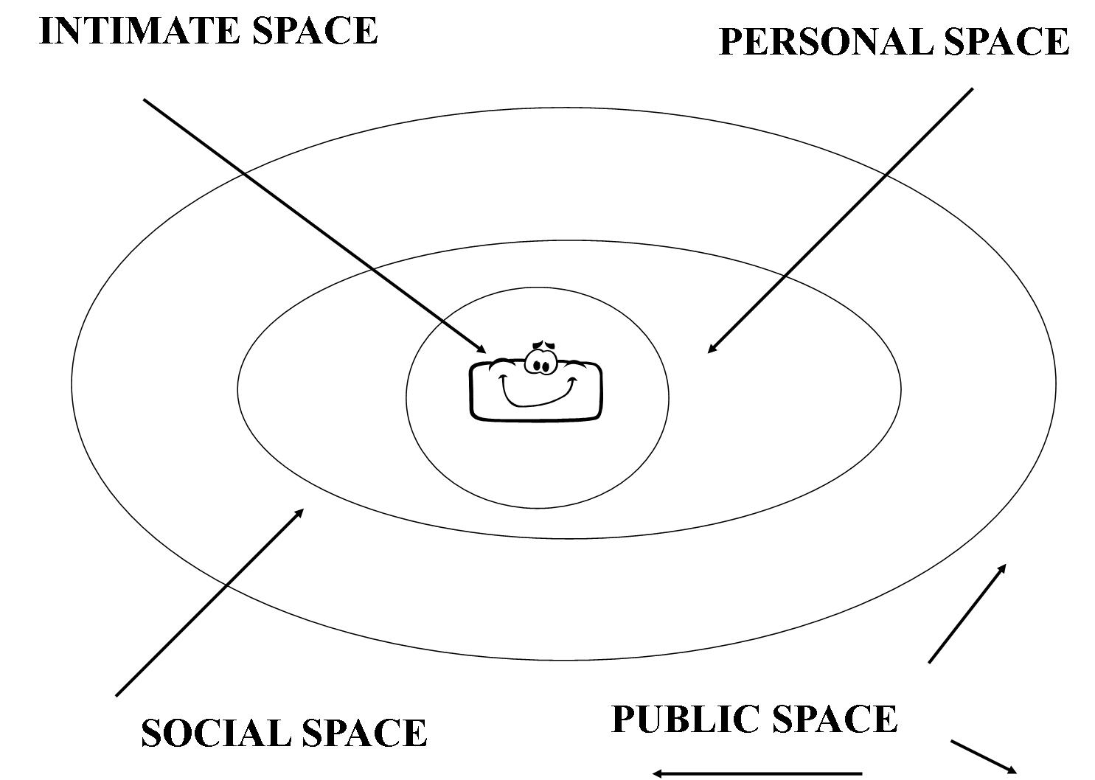
Making Space

Slide 44
Marking Time (Temporality)
When is the right time? People of different cultural backgrounds may give different answers to this question:
At ten o'clock;
At twenty-two hundred hours;
At sunset;
When everything is ready;
When everyone is here; or
When I'm good and ready.

Slide 45
Cultural Competence Continuum
Where do you place yourself along the continuum?
Where do you place your agency along the continuum?

Slide 46
What can you do to move your organization ahead one step in the continuum?

